Slide 1
The Eco-Torah
Leo Dee
Project Coordinator
ICSD
Oct 28, 2019

Slide 2
The Eco-Torah is a Jewish Eco Seminars Project
Eco- Torah
The First EVER
Complete Commentary on the Torah

Slide 3
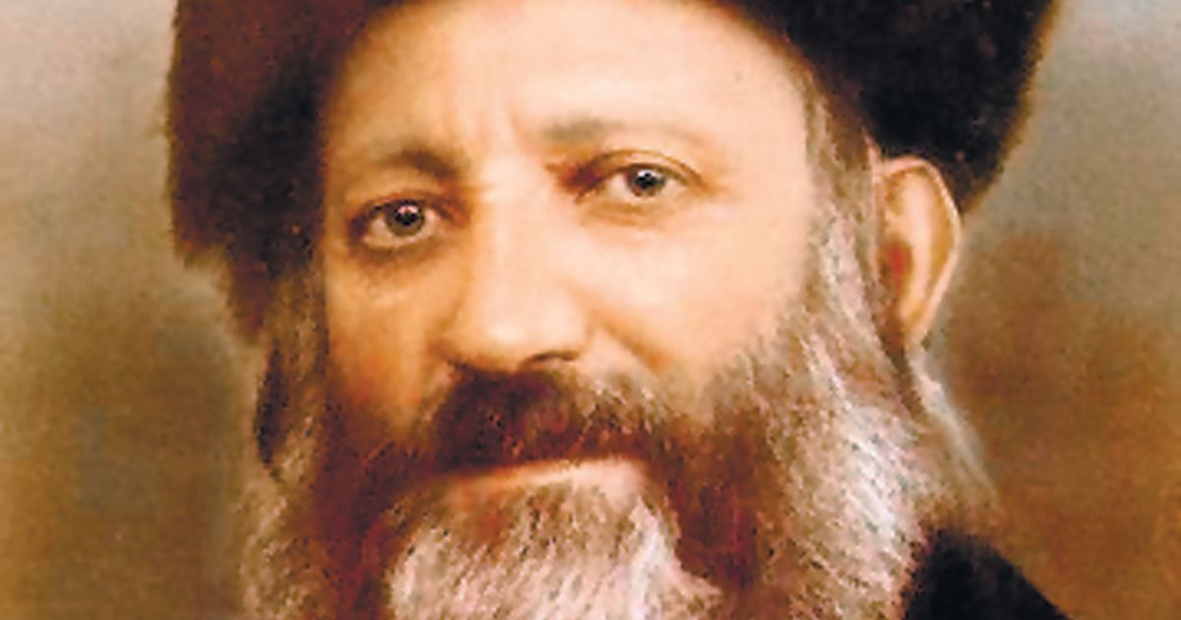
The Torah is, amongst other things, an Ecological Book
Eco- Torah
“The Torah can be understood on four levels:
Individuals
Society
Nations
All of Nature”

Slide 4
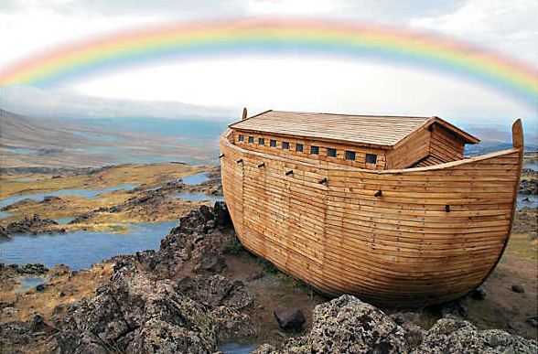
Most people are aware of at least 3 ecological verses
Eco- Torah
“In the Beginning, God created”
(Gen. 1:1)
“God took the man and placed him in the garden of Eden, to till it and tend it” (Gen. 1:15)
“The animals came on 2 by 2”
(adapted from Gen. 7:9)

Slide 5
Eco- Torah
Here’s just some of the verses dealing with Sustainable Living*
Fishing | Gen. | 1 | : | 22
Building | Exod. | 5 | : | 7
Housing | Levit. | 14 | : | 34
Cost sacrifice | Num. | 20 | : | 19
Burial | Num. | 20 | : | 28
Educating women | Num. | 33 | : | 51
Mining | Deut. | 8 | : | 9
Agriculture | Deut. | 20 | : | 5
* Just one of 28 macro themes we have identified

Slide 6
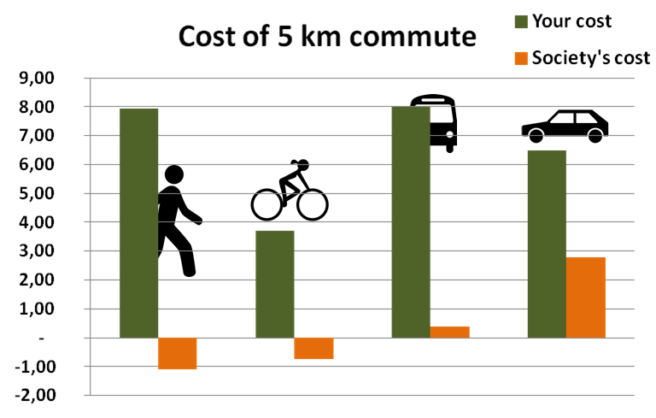
Sustainable Transport
Eco- Torah
“to the Kohathites he did not give any carts or oxen; since theirs was the service of the most sacred objects, their transportation was by shoulder” (Num. 7:7)

Slide 7
Sustainable Water
Eco- Torah
“if we or our cattle drink your water,
we will pay for it” (Num. 20:19)

Slide 8
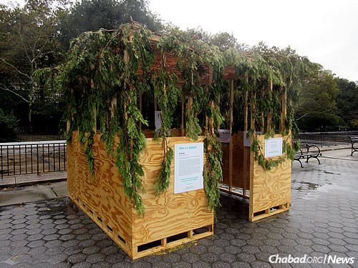
Sustainable Housing
Eco- Torah
“You shall live in booths seven days”
(Lev. 23:42)

Slide 9
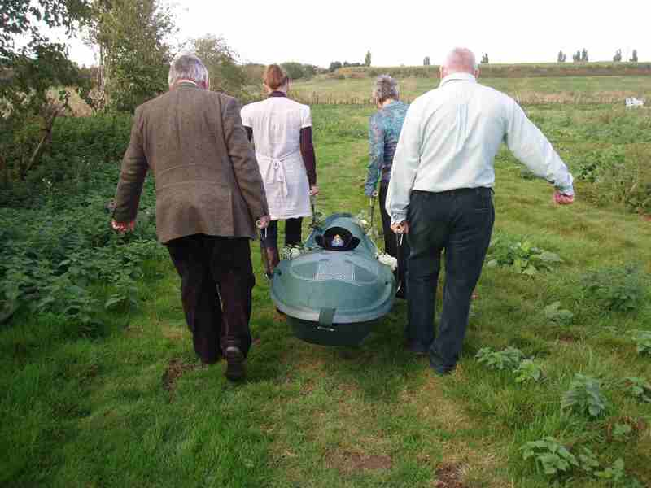
Sustainable Burial
Eco- Torah
Eco Pod
“sell me a burial site among you,
that I may remove my dead for burial”
(Gen. 23:4)
“sell me a burial site among you,
that I may remove my dead for burial”
(Gen. 23:4)

Slide 10
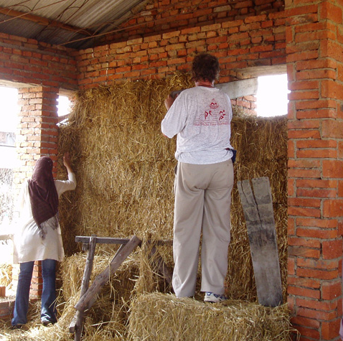
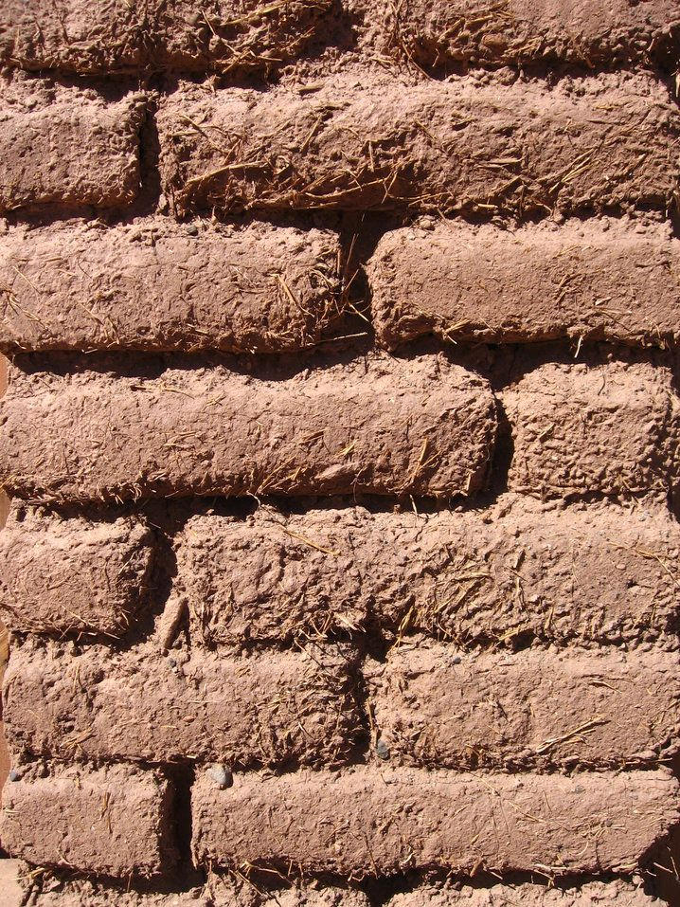
Sustainable Building
Eco- Torah
“straw for making bricks” (Exod. 5:7)

Slide 11
Sustainability as a Value
Eco- Torah
“through it you shall long endure on the land that you are to possess”
(Deut. 32:47)

Slide 12
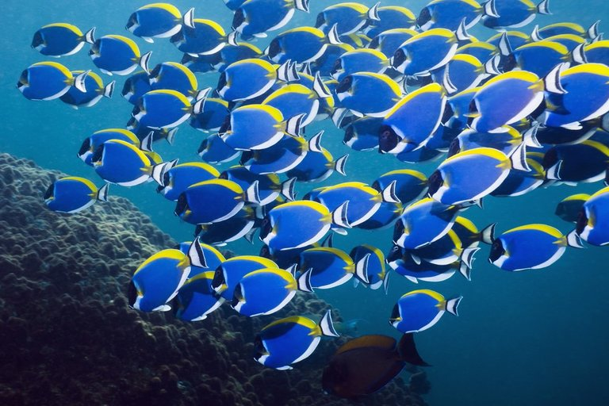
Sustainable Fishing
Eco- Torah
God blessed them, saying, “Be fertile and increase, fill the waters in the seas”
(Gen. 1:22)

Slide 13
Format: Verse; Traditional commentary, &; Ecological insight
Eco- Torah
“Jacob gave Esau bread and lentil soup;
he ate, drank, got up & walked off.
That’s how Esau spurned the birthright.”(Gen. 25:34)
Traditional commentary: “Wicked” Esau ate quickly
Ecological Insight: The Slow Food Movement, innovated by Carlo Petrini¹, advocates a return to healthy food, cooked slowly and a move away from fast food, additives & disposable packaging.
¹ Petrini, C. (2013). Slow food nation: Why our food should be good, clean, and fair. New York: Rizzoli Publications

Slide 14
The Eco Torah has over 350 verse commentaries
Eco- Torah
In 28 diverse ecological themes including:
Closeness to Nature | Ecosystems | Biodiversity
Mankind's Responsibility for Creation | Vegetarianism | Health & Sanitation
Food production | Climate Change | Pollution
Sustainable Lifestyle | Cruelty to Animals | Water Scarcity
Consumerism | Agriculture | Eco Justice
Sustainable Development | Forests | Renewable Energy

Slide 15
We expect to publish the Eco Torah in 2020
Eco- Torah

